Slide 1
SE 577 Software Architecture API Architecture

Slide 2
A historical context
1940s
1960s
1970s
1980s
1990s
2000s
2010s
2020s
CORBA (1991)
XML RPC (1998)
Personal Computer
Computers Did One Thing at a Time for the Most Part
Early days of Networking TCP/IP Invented
Client Server (late ‘80s)
Web Services Rebranded as APIs(2020)
SOAP Web Services(2000)
REST Web Services(2004)
GraphQL(2015)
Socket Based Programming
Enterprise Java Beans (1998)
REST Web Services(2016)
Introduction of Time Sharing Computer Resources Could Be Shared
HTTP/1
HTTP/1.1
HTTP/2
HTTP/3
Distributed Objects
HTTP Based Transports for APIs
Internet / WWW Era
PRE DISTRIBUTED COMPUTING
POST DISTRIBUTED COMPUTING

Slide 3
Versions of Distributed Client/Server Interoperability
Client
Socket
Server
Roll your own Distributed Program
No Standard Wire Format
CORBA/EJB
Client
Socket
CORBA/EJB Server
Distributed Objects
STUB
PROXY
Quasi- Standard Wire Format
API Client
HTTP
API
Server
Client/Server Over Web Protocols
Standard Wire Format

Slide 4
Architecture Challenges addressed with modern Web-Based APIs
Client
Server
No tooling, develop at a very low level
Client and server very tightly coupled because of no OSI standard layer 7 protocol
No support for resilience and scale
Socket
Roll your own Distributed Program
No Standard Wire Format
Provides some benefits, tooling to serialize/deserialize objects
CORBA multi-language, EJB just Java
Provides higher level lifecycle services such as transactions
Interoperability was largely vendor specific / many didn’t follow standards
Vendor specific ways to manage resilience and scale
CORBA/EJB
Client
Socket
CORBA/EJB Server
Distributed Objects
STUB
PROXY
Quasi- Standard Wire Format
Other Object Request Broker Services (e.g., Transactions)
API Client
HTTP
API
Server
APIs ride over all of the innovations and scale that the internet provides
APIs are interoperate because the HTTP protocol is consistently implemented
Vendor differentiation moved to tooling and injecting API specific features into middleware that don’t impact interoperability (e.g., Load Balancing, Traffic Routing, etc)
Client/Server Over Web Protocols
Standard Wire Format

Slide 5
Architecture Challenges addressed with modern Web-Based APIs
Client
Socket
Server
Roll your own Distributed Program
No Standard Wire Format
THESE ARE INTERESTING HISTORICALLY BUT WE WILL NOT BE DISCUSSING IN CLASS
CORBA/EJB
Client
Socket
CORBA/EJB Server
Distributed Objects
STUB
PROXY
Quasi- Standard Wire Format
Other Object Request Broker Services (e.g., Transactions)
API Client
HTTP
API
Server
Client/Server Over Web Protocols
OUR AREA OF FOCUS
Standard Wire Format

Slide 6
The Primary Architecture Pattern of Modern APIs is Client/Server and Layered
WEB BROWSER
HTTP(s) over TCP/IP
WEB SERVER
HTTP(s) over TCP/IP
Request / Response Serialization
API Client Code
API Server Code
Request / Response Serialization
Operating System
HTTP Server Libraries
HTTP Client Libraries
Open Source Libraries
Open Source Libraries
Operating System
If we consider the basic web architecture as a black box (top), we can see that the architecture of APIs basically can ride on top. Think about all of the innovations over the past 10 years to deploy, manage, scale and run web applications, APIs get all of the benefits out-of-the-box. As well as future ones that may come later.

Slide 7
Lets start by taking a look at network protocols – Why?
Network protocols have interesting architectures
Understanding aspects of network protocols will lead to a deeper foundational understanding of web services and APIs
This material will also help with some other content covered in this class – web architectures, cloud native architectures, reactive architectures in particular

Slide 8
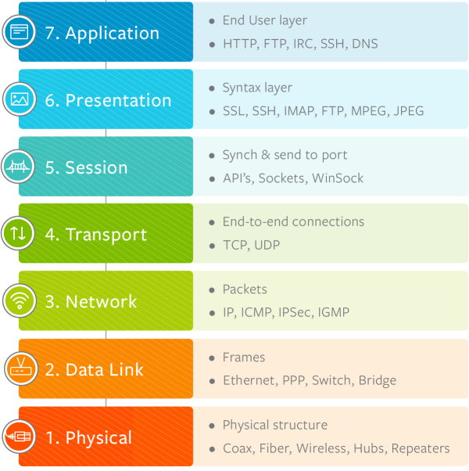
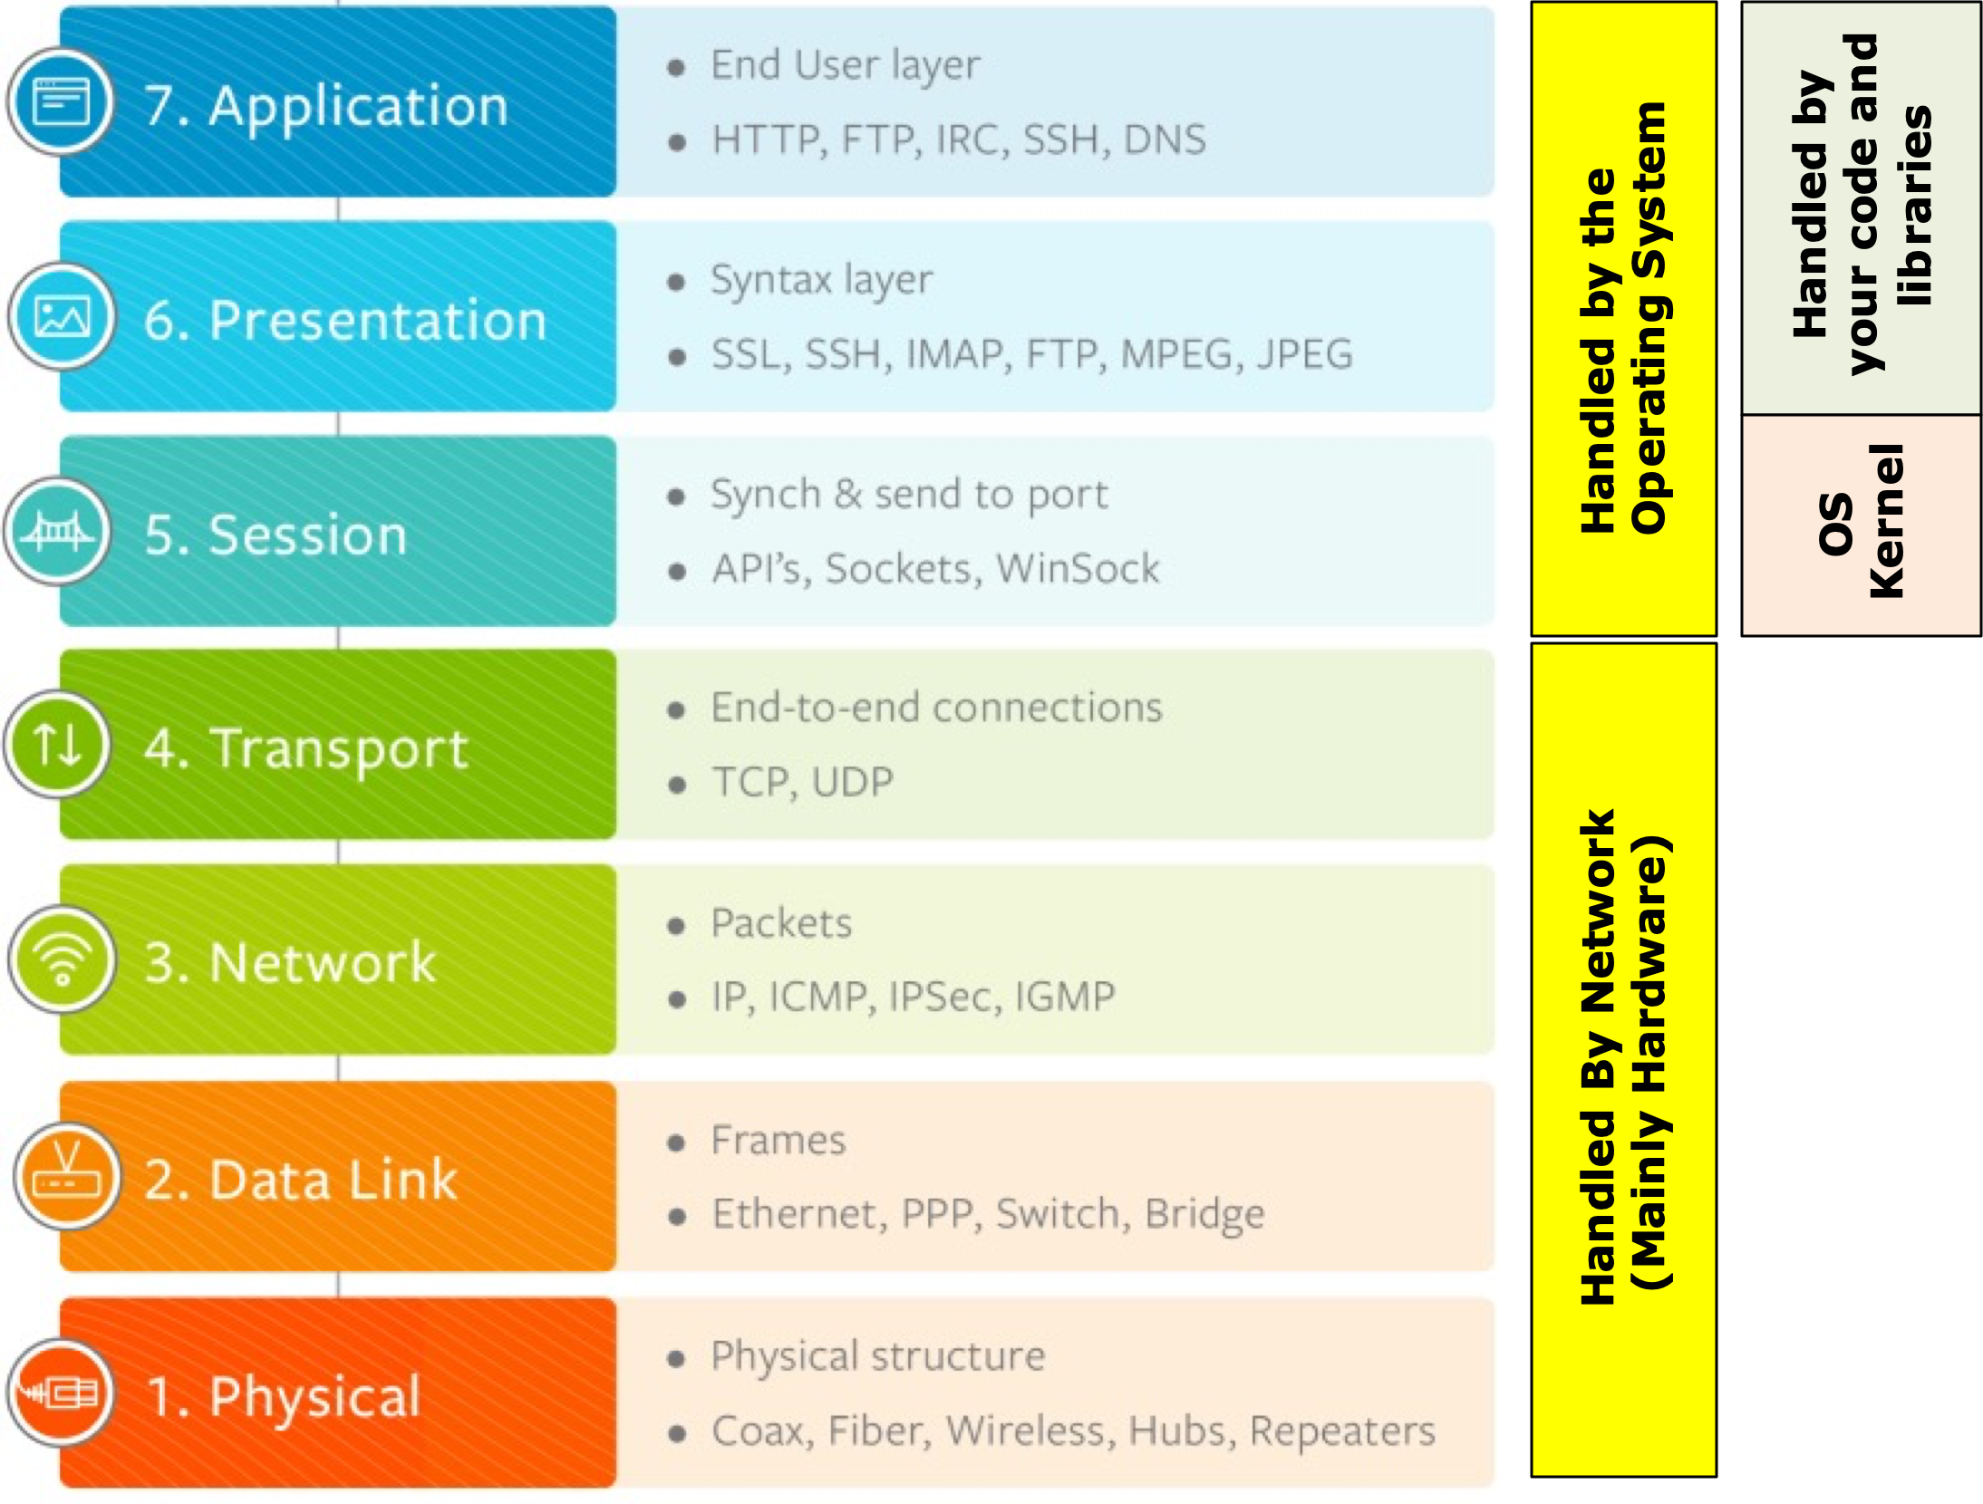
Modern APIs take advantage of the OSI Model from the 1970s – a Layered Architecture
Handled by your code and libraries
API Clients & Servers
Handled by the Operating System
OS Kernel
Handled By Network (Mainly Hardware)

Slide 9
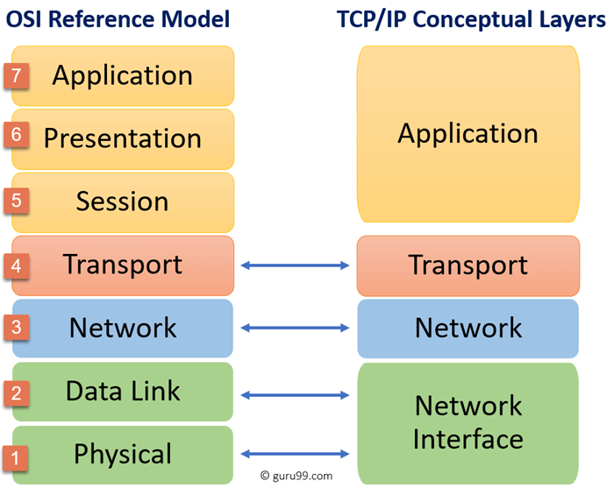
OSI architecture mapped to TCP/IP and UDP/IP
OSI is a REFERENCE ARCHITECTURE; TCP/IP is a concreate architecture
TCP/IP Representative Layers
HTTP TLS
TCP
UDP
IP
Internet
Ethernet WiFi MoCA

Slide 10
TCP vs UDP (this will be helpful later)
TCP
UDP
Rides on top of IP – IP Routes packets
Designed in the 1970s, adopted as a standard in the 1980s
TCP is a connection-oriented protocol –aka Connections are stood up, used and torn down
TCP provides a variety of different services
Like TCP, Rides on top of IP – IP Routes packets
Designed in the 1970s, standardized in 1980
TCP is a connectionless protocol –aka Connection setup is not required, you just send messages
Since its connectionless, its significantly faster than TCP, and includes other features not found in TCP, and supports use cases that don’t require TCPs features
Reliable delivery
Congestion control
Messages delivered in order
Due to efficiency, many use cases can absorb packet loss – e.g., video streaming
Support for broadcast and multicast, TCP is generally peer to peer
In many cases the performance benefits of UDP don’t matter, the main place TCP differs from UDP is connection setup. TCP connection setup requires 3 messages, TCP with TLS connection setup requires 8 messages. UDP has no connection setup requirement! APIs are very heavy in connection setup and tear down!

Slide 11
HTTP has variations V1.1, 2, and 3 (emerging)
HTTP/1 Text Based
HTTPS/1
Text Based
HTTP/2
Binary
HTTP/3
Binary
TLS
TLS
QUIC
TCP
TCP
TCP
UDP
IP
IP
IP
IP
Ethernet WiFi MoCA
Ethernet WiFi MoCA
Ethernet WiFi MoCA
Ethernet WiFi MoCA
1997 Note HTTP/1 is really version 1.1 – 1.0 deprecated
1997
2015
Not officially Released – Reference Implementations Exist

Slide 12
HTTP Protocol - L7 of OSI; App layer of TCP/IP
HTTP VERB
PARAMETERS PROTOCOL
GET https://api.github.com/users/ArchitectingSoftware HTTP/1.1
The current HTTP verb set is GET, POST, PUT, PATCH, DELETE, CONNECT, OPTIONS, and TRACE
HEADERS
Headers are key/value pairs that provide metadata on what is being request, or what is being retuned. Example: “content-length: 350”. See https://developer.mozilla.org/en-US/docs/Web/HTTP/Headers for details. Note you can add custom headers but they should start with x- for example “x-course-id: se577”
Payload
HTTP itself says nothing about its payload structure and format. The payload can be HTML, JSON, etc HTTP/1.1 specifies that the payload is not binary, so if binary data is sent over HTTP/1.1 it must be base-64 encode. HTTP/2 and HTTP/3 use binary formats for the payload which are more efficient to send over a network.
Also note the https:// in the above example. With HTTP/1.1 sending data encrypted is optional so HTTPS indicates secure where HTTP is just plain text. With HTTP/2 and HTTP/3, https is the only option, as non encrypted headers and payloads are not supported

Slide 13
HTTP Protocol Versions Can be Negotiated Client Requested Example
One cool feature of HTTP is that via headers and status codes, HTTP protocol versions can be negotiated between clients and servers. HTTP status codes are well defined in the standard. See https://developer.mozilla.org/en-US/docs/Web/HTTP/Status
-> GET foo.com HTTP/1.1 <- Status-Code: 200/OK
-> GET foo.com HTTP/1.1 Upgrade: http/2 Connection: Upgrade <- Status-Code: 101/Switching-Protocols Upgrade: http/2
Simple exchange, server supports protocol requested by client
Client requests server to upgrade to http/2, server indicates that upgrade is OK
-> GET foo.com HTTP/1.1 Upgrade: http/3, http/2 Connection: Upgrade <- Status-Code: 101/Switching-Protocols Upgrade: http/2
Client requests server to upgrade and gives server a preferred list of protocols, server picks the one it wants and returns it

Slide 14
HTTP Protocol Versions Can be Negotiated Server Enforced Example
One cool feature of HTTP is that via headers and status codes, HTTP protocol versions can be negotiated between clients and servers. HTTP status codes are well defined in the standard. See https://developer.mozilla.org/en-US/docs/Web/HTTP/Status
-> GET foo.com HTTP/1.1 <- Status-Code: 426/Upgrade-Required
Upgrade: http/3, http/2
-> Get foo.com HTTP/1.1 Upgrade: http/2 Connection: Upgrade
<- Status-Code: 101/Switching-Protocols Upgrade: http/2
-> GET foo.com HTTP/1.1 <- Status-Code: 426/Upgrade-Required
Upgrade: http/2
-> Get foo.com HTTP/1.1 Upgrade: http/3 Connection: Upgrade
<- Status-Code: 505/HTTP-Version-Not-Supported Upgrade: http/2, http/1.1
Client wants to use 1.1, but server responds that it supports http/3 and http/2 with http3 being preferred
Client then initiates protocol transfer to what it wants, http/2 in this case
The client is trying to upgrade to http/3 but the server does not support it, so it returns a 505 with a list of protocols it supports in preferred order

Slide 15
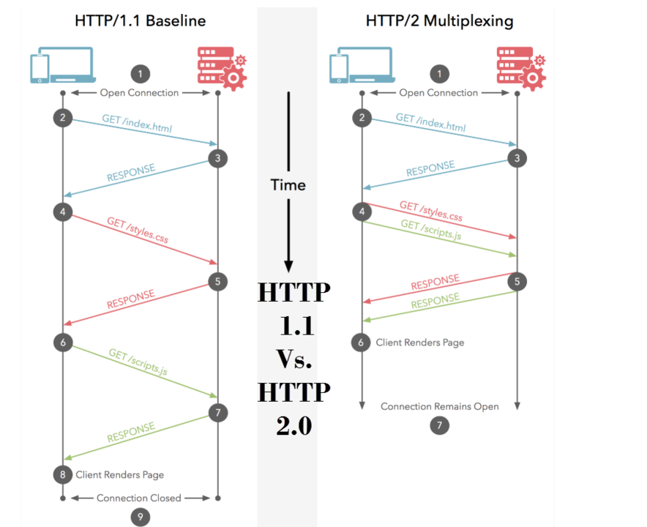
HTTP Evolution – 1.1 to 2.0
HTTP/1.1 sets up and tears down a TCP/IP connection for each request; HTTP/2.0 sets up a persistent connection and keeps it open – big benefits:
Consider a web page or making multiple API calls, TCP setup is expensive
Allows requests to be multiplexed (see picture on left) vs making one request at a time serially
HTTP/2.0 is a binary protocol, which is more efficient to send over the wire than text, which is the HTTP/1.1 standard
HTTP/2 only supports encrypted traffic; this is optional in HTTP/1.1 via http vs https – note HTTP/2 supports non-encrypted payloads for localhost testing only

Slide 16
HTTP Evolution – 2 to 3 – Still under development
Super novel ideal, proposed by Google and working its way through the standards bodies:
Architecturally, TCP really cant be replaced given its baked into intermediary router hardware, it can only be bypassed by using UDP
QUIC provides connection reliability just like TCP
TCP is 40 years old, and has to be general enough to handle any network traffic
We also have 20 years of experience with HTTP and can benefit from a modern connection-oriented protocol that is purposed built for Web and API traffic vs general traffic
Like HTTP/2 encryption is not optional
QUIC can adjust behavior based on connection quality – think wired, vs wifi, vs mobile
HTTP/2
Binary
HTTP/3
Binary
TLS
QUIC RFC9000
TLS
TCP
UDP
IP
With HTTP/3, QUIC replaces TCP for establishing reliable connections
Between clients and servers

Slide 17
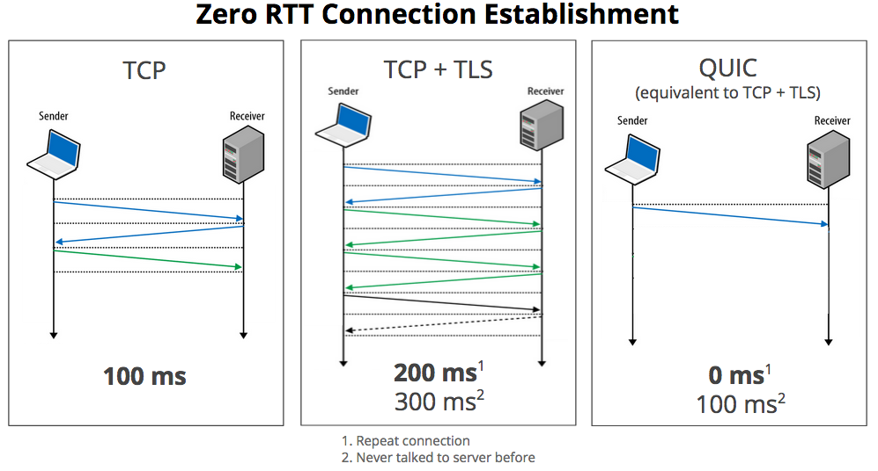
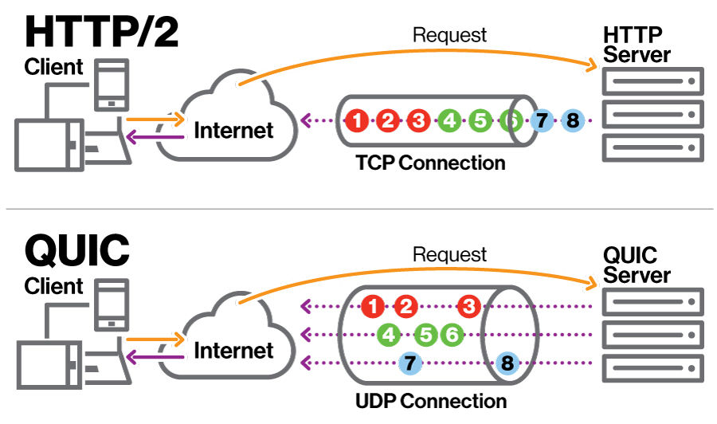
Specific Benefits of QUIC vs TCP for HTTP
BIG BENEFIT #2
Since QUIC uses fast and cheap UDP connections it can use individual UDP sockets to multiplex client calls, since TCP is expensive to setup, multiplexing gets serialized on the TCP connection, leading to buffering inefficiencies such as “head of line” blocking
BIG BENEFIT #1
Since QUIC has knows both sides of the connection will be encrypted it does not have to negotiate it, improving connection setup time dramatically

Slide 18
Wrapping up HTTP
COMMUNICATION PACKET STRUCTURE
PROTOCOL AWARE HEADER
PROTOCOL PAYLOAD – Protocol only tracks length but is just a basic byte array
THUS protocols can be “stacked” where a nested protocol can be put in the payload of a parent protocol
IP
TCP
HTTP
HTTP/1.1 and HTTP/2
IP
UDP
QUIC
HTTP
HTTP/3

Slide 19
BACK to APIs now that we covered HTTP
HTTP(s) over TCP/IP
Request / Response Serialization
API Client Code
API Server Code
Request / Response Serialization
Operating System
HTTP Server Libraries
HTTP Client Libraries
Open Source Libraries
Open Source Libraries
Operating System
OUR FOCUS NOW SHIFTS HERE
OUR FOCUS NOW SHIFTS HERE

Slide 20
Certain aspects of API architectures have evolved over the past 20 years, others have not changed…
WHAT HAS NOT CHANGED: The basic architecture shown BELOW has not changed in the past 20 years. One or more API Clients interact with One or more API servers. In general, the number of API clients exceeds the number of API servers dramatically
HTTP(s) over TCP/IP
Request / Response Serialization
API Client Code
API Server Code
Request / Response Serialization
Operating System
HTTP Server Libraries
HTTP Client Libraries
Open Source Libraries
Open Source Libraries
Operating System
MANY
FEW
WHAT HAS CHANGED: (1) VOLUME – 20 years ago we measured volume in dozens of concurrent connections and hundreds-of-thousands to low millions of calls per year… now we measure volume in thousands of concurrent connections and billions of calls per year. (2) PERFORMANCE – 20 years ago 3-5 seconds was acceptable, now anything over 500 ms is considered slow, we target under 100ms in general. (3) RESILIENCY – 20 years ago 95+% availability was OK; now anything less than 99.9% is considered bad. (4) SECURITY – 20 years ago APIs were internal only, now they are a major attack vector so security is essential.

Slide 21
API Components
API Client/Server Code
For API-based architectures we need:
A way to serialize and deserialize data structures that will be exchanged between the client and server that is language agnostic
Libraries that provide simple abstractions to send and receive data without knowledge of the underlying network protocol requirements
The ability to support important resiliency patterns such as health checks, retries, timeouts, circuit-breakers, etc given this is a distributed system
The ability to observe and trace distributed calls end-to-end for performance optimization and debugging
The ability to supervise servers to ensure that they are running and are healthy, and to automatically restart and scale them out as needed
The ability to ensure that the clients and servers trust each other from a security perspective, and are hardened to common attacks
Request / Response Serialization
Open Source Libraries
HTTP Libraries
Operating System

Slide 22
XML-RPC and SOAP (late ‘90s – early ‘00s)
IP
TCP
HTTP
SOAP
For the most part, SOAP was a protocol encapsulated in HTTP and was sent from clients to servers in an HTTP POST
Like all other protocols, SOAP separated Headers that were used as Metdata, from the payload which was used to communicate request calls, and responses in XML
EXAMPLE: A SOAP REQUEST
<?xml version="1.0"?>
<soap:Envelope xmlns:soap="http://www.w3.org/2003/05/soap-envelope">
<soap:Header>
<h:LevelOfDetail> Summary </h:LevelOfDetail>
</soap:Header>
<soap:Body>
<m:GetUser>
<m:UserId>123</m:UserId>
</m:GetUser>
</soap:Body>
</soap:Envelope>
SOAP Header
SOAP Payload (any XML)
SOAP Structure

Slide 23
XML-RPC and SOAP (late ‘90s – early ‘00s)
IP
TCP
HTTP
SOAP RESPONSE
SOAP RESPONSES TOOK THE SAME STRUCTURE AS A REQUEST BUT HAD AN OPTIONAL OTHER VERB CALLED A “FAULT” THAT COULD BE RETURNED IF AN ERROR HAPPENED
EXAMPLE: A SOAP RESPONSE
<?xml version="1.0"?>
<soap:Envelope xmlns:soap="http://www.w3.org/2003/05/soap-envelope">
<soap:Header>
<h:LevelOfDetail> Summary </h:LevelOfDetail>
</soap:Header>
<soap:Body>
<m:GetUserResponse>
<m:First-Name>B rian</m:First-Name>
<m:Last-Name>Mitchell</m:Last-Name>
<m:Gender>Male</m:Gender>
<m:OtherStuff>Foo-Bar</m:OtherStuff>
</m:GetUserResponse>
</soap:Body>
</soap:Envelope>
SOAP Header
SOAP Payload (any XML)
SOAP Structure

Slide 24
XML-RPC and SOAP (late ‘90s – early ‘00s)
IP
TCP
HTTP
SOAP RESPONSE
SOAP RESPONSES TOOK THE SAME STRUCTURE AS A REQUEST BUT HAD AN OPTIONAL OTHER VERB CALLED A “FAULT” THAT COULD BE RETURNED IF AN ERROR HAPPENED
EXAMPLE: A SOAP RESPONSE WITH A FAULT
<?xml version="1.0"?>
<soap:Envelope xmlns:soap="http://www.w3.org/2003/05/soap-envelope">
<soap:Header>
<h:LevelOfDetail> Summary </h:LevelOfDetail>
</soap:Header>
<soap:Body>
</soap:Body>
</soap:Fault>
<Code>1234</Code>
<Message>User Not Found</Message>
</soap:Fault>
</soap:Envelope>
SOAP Header
SOAP Payload (any XML)
SOAP Structure

Slide 25
SOAP Protocol
The Soap protocol used XML and wrapped SOAP messages in the <Envelope> tag
The <Envelope> tag was allowed to encapsulate the <Header>, <Body>, and <Fault> tags
ISSUES
The data contained under the standard tags was not standardized beyond having to be valid XML, thus techniques had to be used to communicate data schema expectations between the client and the server
Every request customized what was expected of the server, and every response had to react to the request
XML processing is verbose and tends not to be super performant for large payloads
SOAP was encapsulated inside of the HTTP packet, yet it took zero advantage of the HTTP protocol itself

Slide 26
SOAP – Design by Contract
To address the fact that every SOAP request and response could be structured in any way, best practice evolved to “design by contract”
The definition of the structure and semantics of requests and replies was defined in an XML quasi-schema language called XSLT
Tools parsed XSLT and generated custom proxies and stubs to serialize and deserialize to SOAP request and response structures
SOAP Client Code
SOAP Runtime
XSLT Definition (in XML)
XSLT Compiler
Serialization and Deserialization Code
SOAP Server Code

Slide 27
SOAP – Challenges with SOAP Design
SOAP clients made request to the SOAP server using “verbs”, AKA – go do this, go do that, which lead to massive sprawl and no standards for how to interoperate
GetCustomerByFirstName, GetCustomerByID, GetCustomerByAddress, …
SOAP did not use any of HTTP to manage traffic, scale, routing, etc so custom SOAP servers were required – e.g., IBM WebSphere, etc. Each one of these customer vendor offerings had their own story around how/why they scaled and ran better than other vendor offerings
Because the serializers, and deserializers were provided by the vendor there were interoperability challenges if you tried to use code compiled against IBM Websphere with BEA Weblogic – this was by vendor design
XML lead to big payloads, and in the early 2000’s networks were not what they are today

Slide 28
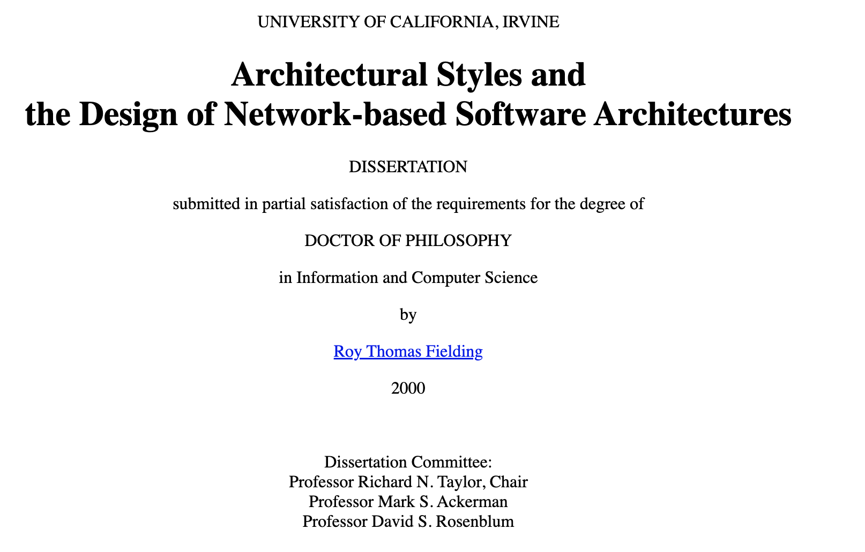
Then came REST circa 2000-2004
At the same time engineers started to use SOAP, Roy Fielding wrote his PhD thesis (2000) that suggested an alternative architecture
By 2004 people were starting to play with this model, and it became the defacto-standard a few years later
It was called REST, REpresentional State Transfer
REST is an architecture for distributed hypermedia systems

Slide 29
Guiding Principals for REST Uniform Interfaces
Uniform Interfaces in REST – REST manipulates RESOURCES
Resources are like objects in OO, or an entity in a DB
Identification: The interface must uniquely identify each resource
Manipulation: Servers should return resources to clients in a uniform way, and clients should use these representations in a standard way to manipulate the state of the resource
Self-Descriptive Messages: Resource messages should be self descriptive, they should not only contain information on the resource itself, but also include additional actions that a client can perform
Hypermedia as the engine of Application State (HATEOAS): The client should have only the initial URI of the application. The client application should dynamically drive all other resources and interactions with the use of hyperlinks

Slide 30
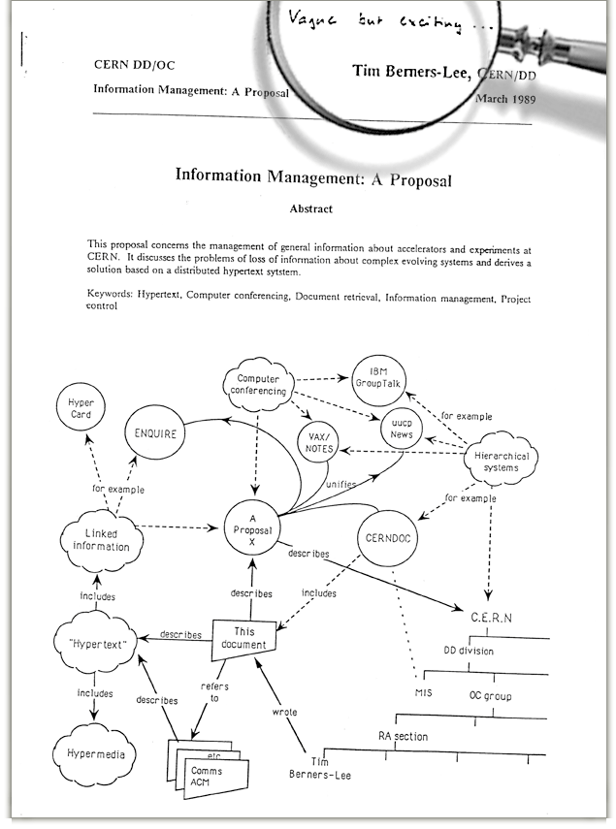
History of the Web – circa 1989/1990
In March 1989, Tim Berners-Lee wrote a proposal that outlined the architecture of the web
Initial proposal was considered vague and not well received, it was revised and eventually accepted in October 1990
Introduced the concepts we know today:
HTML: Formatting/Markup
URI: Addressing approach (now generally called URL)
HTTP: The protocol for encoding and transmitting information over the web

Slide 31
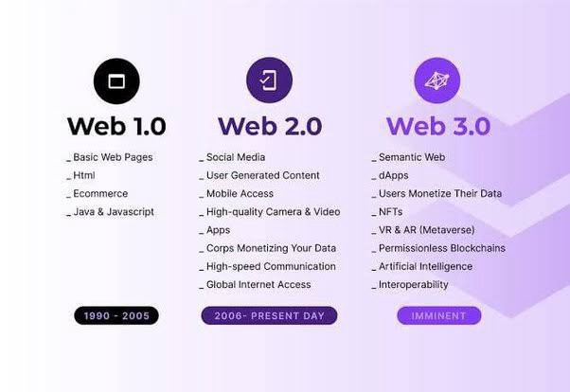
Web 1.0, 2.0, and perhaps soon 3.0

Slide 32
Web 1.0 – The “Read Only Web” Architecture
Web
Browser
Web
Server
File System
HTTP
ReadFile
Files Stored in HTML
Advantages
Simple
Cachable
Indexable
Disadvantages
No dynamic content
No interaction with user
All requests must go back to server

Slide 33
Web 1.0.1 – The Common Gateway Interface (CGI) Circa 1993
Architecture Changes
Web server acts as router
.html files returned from filesystem
.cgi extension resulted in web server executing a new process that piped information via stdin and stdout
CGI programs generated HTML directly
Enabled the web to start to support transactional personalized experiences
Since CGIs are just programs, they were often developed in languages like C and/or Perl
Architectural challenges
Scale – all CGI ran as a process
Interactivity, all actions from the browser had to travel over the network to the server
Web
Browser
Web Server
File System
HTML
Resource Manager
stdin / stdout
CGI
Script
Database

Slide 34
Web 1.0.2 – Javascript Circa 1995
Architecture Changes
Web
Browser
Web Server
Web Browser gets Smarter
HTML can now embed or link to javascript that can be executed on the browser
Code running directly in browser improves user experience
Enabled some user behavior to be processed in browser avoiding trips back to the server
Architectural challenges
Same as 1.0.1, plus,
Code redundancy, often checks had to be made both in the client (javascript) and the server (CGI)
Javascript was developed in 10 days and has always been regarded as a poor language
Javascript compatibility was very poor for the first 20 years of its existence leading to workaround solutions like jQuery becoming popular
File System
HTML
Resource Manager
Javascript Engine
stdin / stdout
CGI
Script
Database

Slide 35

Web 1.0.3 – The Application Server - Circa 1999
Architecture Changes
The CGI handler was replaced with a totally new architecture
CGIs were processed based
CGIs had to communicate via stdin and stdout to a local file system
Application servers replaced CGI with interfaces that streamed HTTP over a network protocol (could be localhost, but could also be anywhere)
Application Server managed the lifecyle of applications – called webapps
Webapps could be run in threads instead of processes
Libraries were created that abstracted HTTP and HTML from developers
Web
Browser
Web Server
File System
HTML
Resource Manager
Javascript Engine
http
Application Server
Database
WebApp
Apache Tomcat 1.0

Slide 36


Web 1.0.4 – The Application Framework - Circa 2000-2003
Architecture Changes
Previous generation provided code libraries to help translate code data structures to HTML
Improvements with MVC
Server side code could be much better modularized, which supported creating larger applications
HTML rendering code replaced with markup files for the view that can be translated into code and pre-compiled for speed
Behavior can be altered via configuration
Challenges
Configuration files that controlled code execution became complex and difficult to maintain (not to mention debug)
Web
Browser
Web Server
File System
HTML
Resource Manager
Javascript Engine
http
Application Server
Database
WebApp
MVC Framework
Spring MVC (2003)
Apache Struts (2000)

Slide 37
Web 2.0 – Circa 2005/2006
Web
Browser
Web
Server
Web
Application
TCP
Web Data
WEB 1.0
HTTP
HTTP
Browser/ Mobile / IOT
Web Services (APIs)
TCP
Web Data
HTTP w/JSON/XML Payload
WEB 2.0
“Web”
Application
The primary architecture shift in web 2.0 is that the application itself moves to running on the client and the client types expand from just a browser to mobile and IoT

Slide 38
Web 2.0 starts by exploiting a little known feature called XHTR (XML Http Request)
In 1998, Microsoft developed the concept behind XHTR to support a web-based mail program which was first shipped with IE5 in 1999
This “feature” was inconsistently implemented in a variety or browsers over the early years
In 2004, Google saw the promise of XHTR and creaed a browser compatible javascript library that they needed to support a new generation of applications they were creating – Gmail in 2004, and Google Maps in 2005
In 2006, XHTR was released as a standard by the W3C - https://www.w3.org/TR/2006/WD-XMLHttpRequest-20060405/
Like most interesting things, the enabler for web 2.0 was introduced for a totally different purpose and then later exploited to enable things we use today

Slide 39
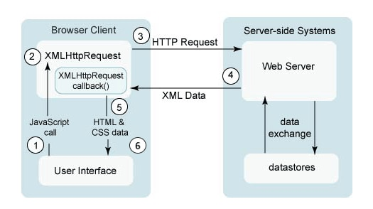
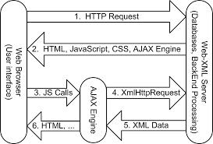
What does XHTR (and AJAX) enable along with its architecture?
Terminology, XHTR is often talked about with something else called AJAX – Ajax stands for asynchronous javascript and XML
AJAX is the API component that the browser uses, XHTR is the structure of the object that interacts with servers over HTTP

Slide 40
Capabilities enabled by the Web 2.0 Architecture
Web 1.0 was about the evolution from static content to dynamic content
Web 2.0 is about running fully featured applications over the web protocols
Multi-Client – not just web browsers but mobile and IoT devices
Web 2.0 also brought with it extensions to the underlying HTTP protocol
HTTP/2.0 – Switch from non-persistent to persistent connections; Switch from text to binary payloads
MQTT – A queue based lightweight, low-energy protocol suitable to support fleets of IoT devices running embedded web 2.0 applications
Most basically stated – Web 2.0 is about being able to do useful things over the Web

Slide 41


Web 2.0 – Circa 2005
Architecture Changes
Content Provider
Cloud CDN
Javascript Bundle
Introduction of multiple new components
Content provider: Browser downloads application code either via a web server or a content delivery network
Once application is downloaded, it is bootstrapped and executed 100% in browser
Application makes requests over HTTP to APIs using Ajax
To manage scale and security, purpose built proxies are deployed; a WAF for security, and an API gateway to manage the APIs
Challenges
Javascript is complex to create and maintain these types of applications
Download
Cloud
Web
Browser
Web Server
File System
Javascript Bundle
Javascript Engine
Javascript Application Ajax()
API Runtime (K8s, VM, Serverless)
API Gateway
Web Application Firewall
API
API
API
XHTR (XML/JSON)
API
API
API
API
API
API
Google Maps
GMail

Slide 42





Web 2.x – Circa 2008-today
Web
Browser
Content Provider
Cloud CDN
Javascript Bundle
Architecture Changes
Cloud
Introduction of multiple new components
Single Page Application (SPA) Frameworks mature to make developing modern web applications significantly easier
Mobile Apps arise with nice SDKs that reuse the web platform for data exchange
IoT devices become very popular – IoT devices have varying capabilities and power thus multiple integration paths are supported – direct HTTP/JSON, MQTT over TCP, or specialized low power protocols such as Z-Wave, ZigBee, Bluetooth, etc
Javascript Engine
Web Server
SPA Framework
File System
Javascript Bundle
SPA Application
Mobile
API Runtime (K8s, VM, Serverless)
Mobile App
Web Application Firewall
API Gateway
API
API
API
IoT Device
IoT App
API
API
API
MQTT Gateway
Low Power
API
API
API
IoT Gateway
Google Maps
GMail

Slide 43
Web 2.x Summary
Web
Browser
Content Provider
Cloud CDN
Javascript Bundle
For all practical purposes this is the current state of the web
Web 1.0 was about delivering rich content
Web 2.0 is about using the web architecture to do useful things
Architecture Pivots
Application code delivered to client remotely – benefits, easy patching and updates
Application runs locally on client – provides limitless scale
Data and remote functions provided by APIs – numerous architectural innovations here as well (more to come on this topic)
Cloud
Javascript Engine
Web Server
SPA Framework
File System
Javascript Bundle
SPA Application
Mobile
API Runtime (K8s, VM, Serverless)
Mobile App
Web Application Firewall
API Gateway
API
API
API
IoT Device
IoT App
API
API
API
MQTT Gateway
Low Power
API
API
API
IoT Gateway
Google Maps
GMail

Slide 44
Single Page Application Architecture - SPA
Web
Browser
Web Page
Web Component
Networking
Page Component
Component Template
Security
Children
Children
Component Styling
Layout Engine
Child
Child
Child
Child
Child
Component Behavior
Styling Engine
Component Events
C
C
C
C
C
C
C
C
C
Local Storage
Kind of Trivial but Web Pages can be thought of as a hierarchy of components, where components nest, the leafs of the webpage are native controls such as entry fields, static text, buttons, etc
Web Components in an SPA consist of a template for layout, styling for look/feel, Javascript/Typescript code to manage behavior, and an eventing framework to communicate with other web components
Javascript Engine
Google Maps
GMail

Slide 45
SPA Frameworks
Building SPAs by hand can be very complicated, over the years multiple frameworks and libraries have been introduced to make this easier. Top frameworks are React, Vue, Angular, and most recently Svelte.
SPA Architecture
Web Component
Web Component
Manager
SPA Framework
SPA Tooling
SPA Community
Component Template
Routing
Command Line Tools
Libraries
Create
Component Styling
Utilities
Destroy
State Management
Compiler Optimizer
Component Behavior
Lifecycle Events
Plugins
Rendering Optimizer
Packaging
Testing
Component Events
Component Events
Libraries
Event Manager
Prebuilt Components
Deployment
Google Maps
GMail

Slide 46
SPA Frameworks
SPA Components are event-driven, almost all interesting interactions happen over sending and reacting to asynchronous events.
SPA architectures often have abstractions for the network interfaces that treat ingress and egress network interactions as events
State management for SPAs (discussed soon) is often facilitated via variations to the flux pattern. This pattern features state being managed in an immutable store, and uses events to query, mutate or react to changes in the store
User interface updates are handled entirely locally, they can be full page swaps, which are driven by the router, or they can be incremental page updates based on reacting to user behavior (clicking a button, pressing a key, etc) SPA Web Components, via an interaction manager, can communicate with each other via sending events, and reacting to callbacks.
SPA Architecture
Router
SPA Rendering Controller
SPA WEB COMPONENTS
SPA Component Interaction Manager
Network
Events
State Management
Google Maps
GMail

Slide 47
SPA Component Interaction Best Practices
SPA Architecture
Remember, SPAs create hierarchies of components
There are strict parent/child relationships
Best practice, when a parent creates a child, it passes all properties that that child needs. These take the form of:
SPA Parent Component
callBackFunction(Parameters, …) {
…
} <CHILD prop= [p1,p2, pn], callback = [f1(), f2(), fn()] />
Properties, or props – think of these as a web component constructor, the parent passes data to the child for initialization
Callback functions – as the child component runs, sometimes it needs to notify the parent about interesting things, such as state changes or anything else of interest. The parent passes a callback function to the child, that the chid can use to interact with the parent
PROPERTIES AND CALLBACK FUNCTION REFERENCES
Callback Notifications
SPA Child Component
Setup(properties, …) callBackFunction(Parameters, …);
SPAs are very strict on flow of direction, properties flow down, callbacks / events flow up

Slide 48
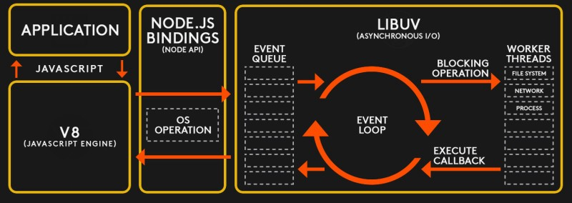
The architecture of Javascript, and more importantly its runtime
The javascript runtime is single threaded with an event loop at the center, effective use of asychonous programming techniques is essential to making these applications perform well.
Because most web architectures are I/O bound this model works well, but specific strategies are required for compute bound workloads in order to ensure that work is processed efficiently.

Slide 49
The architecture of Javascript, and more importantly its runtime
The javascript programming model provides multiple models for doing async programming
function after(args) {
//post processing here
}
function do_something(args, cb{
//do some work cb(args)
}
function client() {
do_something(”hello”, after) }
var promise = new Promise(function(resolve, reject) {
// do a thing, possibly async, then…
if (/* everything turned out fine */) {
resolve("Stuff worked!");
}
else {
reject(Error("It broke"));
}
});
//calling it promise.then(function(result) {
console.log(result); // "Stuff worked!"
}, function(err) {
console.log(err); // Error: "It broke"
});
Callback example – do some work let me know when you are done
Async with Promises

Slide 50
The architecture of Javascript, and more importantly its runtime
The javascript programming model provides multiple models for doing async programming
async function worker() {
data = await call_database(); status = await web_service_call()
return status
}
//calling it let s = worker()
console.log(s);
async function f() {
return 1;
} //async functions return promises
f().then((v) => console.log(v)
Async functions return promises so you can just code them as such
async function f() {
return 1;
} let v = await f()
console.log(v)
Using async/await together, notice how this async code looks sync
Note that javascfipt also has a future called a generator that is used to break up compute intensive work, if you have interest in this please ask a question.
You can use await to make async code look synchronous

Slide 51
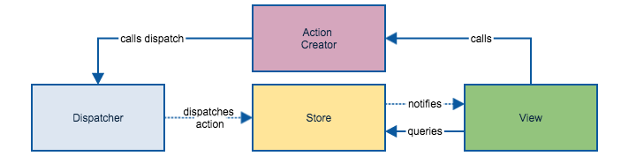
Now we know enough to look at how state management is handled in SPAs
The best architecture pattern for handling state is called flux https://facebook.github.io/flux/
The key to this pattern is that all information flows in one direction and all interactions between the components are carried over events
Note that flux is a pattern and there are various implementations of this pattern that have been encapsulated in libraries – Redux, Vuex, Pinia

Slide 52
Pinia state management example
import { defineStore } from 'pinia’
export const useCounterStore = defineStore({
id: 'counter’,
state: () => ({ counter: 0 }),
getters: { doubleCount: (state) => state.counter * 2 },
actions: {
increment() { this.counter++ } ,
async callWebService() { http.get(…)}
}
})
//using in your components
const counterStore = useCounterStore()
counterStore.inrement() counterStore.callWebService() console.log(counterStore.counter)
Console.log(counterStore.doubleCount)
let {counter} = storeToRefs(counterStore) //reactive counters reacts to changes
Store setup, define the state properties and initial values
Calculated properties State not mutated
Action that mutates state – notice this keyword
Action can be async as well

Slide 53
Wrapping up Web2 – Overall Reference Architecture
Cloud or On Premise Compute
Network/Subnet Management
Identity Provider IdP
Control Plane
API Data
API Documentation Server
Kubernetes
API
API Data
API Gateway
API Runtime/Supervision
Client Browser, Mobile App, IoT
API Routing
API Data
Third Party Security Services
API
Data Leak Protection(DLP)
Ingress Firewall
API Data
Bot Detection
Application Execution Context
Web Application Firewall
API Traffic Management
PROXY
Server;ess
API Data
API Security
API
API
API Data
API Analytics
End-to-End Config/Misconfiguration Management
Google Maps
GMail

Slide 54
Wrapping up Web2 – Overall Reference Architecture – Component Description
Component | Description
Application Execution (context) | Web 2.0 applications generally execute directly on the client. The client can be a web browser, a mobile device, or an IoT device. The most popular approach is to use single page web application (SPA) technology frameworks such as Angular, React, Vue or Svilte on the client. Emerging technology is web assembly
Data Leak Protection | Often offered by a third party that runs as a hosted service. This component observes all ingress and egress traffic looking for suspicious traffic being sent to destination locations. The objective is to prevent data from leaking.
Bot Detection | With the dark web, and the tendency to reuse passwords, Bots hit various websites using known credentials to try to break into other sites. This is known as credential stuffing. Bot detection solutions apply AI techniques to determine if security/login endpoints are being interacted with by a human or a BOT. Captua technology is a common defense. Shape security is an example provider of such services.
Ingress Firewall | The ingress firewall manages network connections at the edge. They do a varity of things including blocking unwanted TCP/IP ports. Its common for these firewalls to block anything outside of port 443 (HTTPS)
Google Maps
GMail

Slide 55
Wrapping up Web2 – Overall Reference Architecture – Component Description
Component | Description
Web Application Gateway (WAF) | The WAF is aware of L7 protocols such as HTTPS and can apply rules to block certain types of attacks. Attacks addressed by WAFs include SQL Injection, Cross Site Scripting, Ddos, Cookie based attacks, etc. Examples: AWS WAF, F5
Data Leak Protection | Often offered by a third party that runs as a hosted service. This component observes all ingress and egress traffic looking for suspicious traffic being sent to destination locations. The objective is to prevent data from leaking.
Identity Provider (IdP) | The identity provider is a security component that handles authentication and authorization services. It can act as a reverse proxy ensuring clients are using secure sessions, or support protocols such as oAuth and issue and validate tokens either in a proxy mode or by providing security signing services to validate tokens. Examples: Okta
Network Subnet Management | These services can be offered via physical network design, or logical network design in the cloud. They can be facilitated by switches, firewalls or cloud based network access controls. The purpose of this component is to ensure that different services are isolated into different subnets and that clear rules are executed that specify what traffic can cross subnet boundaries.
Google Maps
GMail

Slide 56
Wrapping up Web2 – Overall Reference Architecture – Component Description
Component | Description
End to End Configuration Management | Ofen deployed in the cloud, these services constantly watch infrastructure and ensure that the deployed configuration manages the desired configuration. This includes what components are running along with their configuration. Example: Cloud Custodian
API Gateway | The API gateway is a critical piece of infrastructure to manage, as it name states, APIs. API gateways include services to manage APIs, to manage access to APIs, to document API interfaces and to manage traffic policies for APIs (e.g., rate limiting, circuit breakers, etc). Examples: Gloo Edge, Envoy, Kong
API Runtime Supervision / API Control Plane | As APIs execute, they benefit by being supervised by a component that manages their availability and scalability – being able to scale up, scale down, detect and restart ill behaving API runtime containers. Examples: Kubernetes, AWS Lambda.
API Data | This layer of the architecture is responsible for providing data to the APIs. Often time it is delivered via special purpose NoSQL databases that are designed for horizontal scale. Examples: MongoDB, DynamoDB, CosmosDB, DocumentDB, etc.
Google Maps
GMail

Slide 57
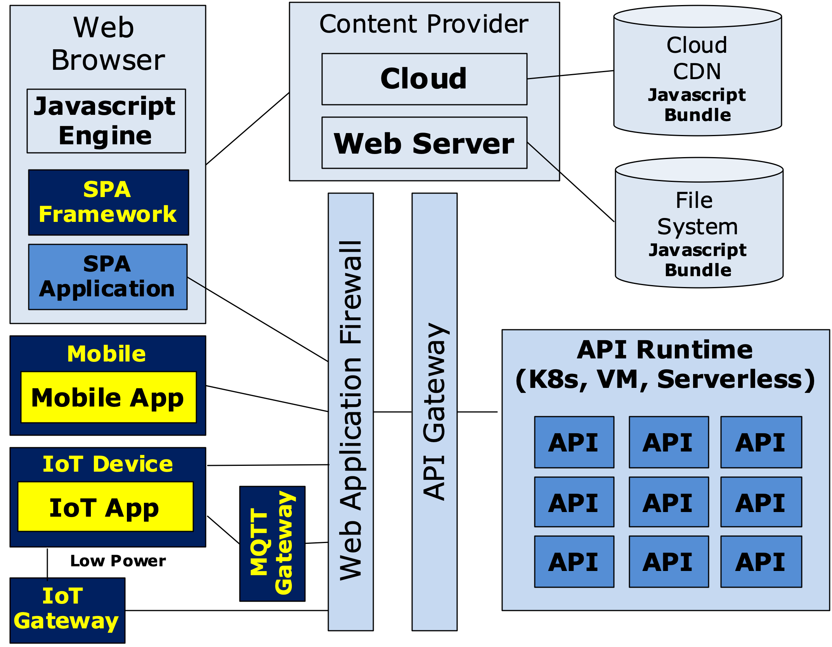
Web 2.x Architecture Summary
The Web 2.0 architecture has served us very well, but there are some challenges that are calling for an architecture pivot
Although the architecture of the web is highly scalable and distributed, much of the internet is controlled by central parties
Google (search), Facebook, Netflix, Amazon, etc
Platforms: Amazon AWS/ Microsoft Azure, Google GCP
Many of the backend services provided by APIs are owned by entities that require knowing who you are
Banks, Insurance Companies, Entertainment Providers, Ecommerce Suppliers, etc
Think about the number of accounts and passwords you have, each is for a different entity
While its still too early to see where this is going architecturally, we are starting to hear about Web 3.0
Google Maps
GMail

Slide 58
Web 2.x Security Architecture – Session Based
Credentials Store (e.g, LDAP)
Security Proxy
Web Services
--→ Login UserId/Password in POST header
Client
Authentication endpoint
Secure Web API
Browser
←-- Login Response Session ID via secure session cookie if OK HTTP/200 OK; 401 Not OK
Session Cache
Mobile
--→ API Call Proxy Request if Session OK
--→ API Call Session Cookie Passed in Header
Secure endpoint
Public endpoints
Public Web API
--→ Public API Call
Pass through
Google Maps
GMail

Slide 59
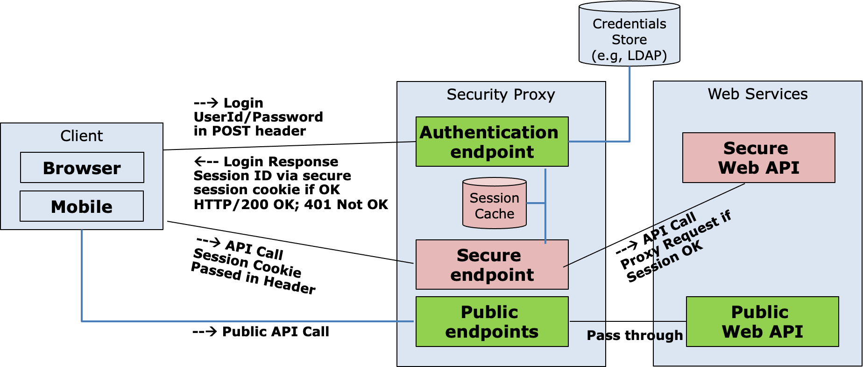
Web 2.x Security Architecture – Session Based Architecture Strengths and Weakness
Works well, time tested
Very secure assuming payloads, and therefore headers are encrypted over HTTPS
Issue: Many single points of failure – Proxy, LDAP
Issue: Very difficult to cluster given session cache has to be distributed, or sticky sessions are required to “stick” a client application to an instance of a proxy
Issue: Very difficult to federate, for example you want to use a third party to authenticate a user –e.g., Microsoft, google, amazon, twitter
Issue: Works well for web browsers because cookies are a natural part of the ecosystem, but need to be supported by the client directly for other clients such as mobile applications
Google Maps
GMail

Slide 60
Using oAuth for security
Most modern security approaches are based on oAuth 2.0
oAuth uses tokens to ensure security
Tokens can be opaque or packaged as JWTs
Opaque Tokens Carry No Meaningful Information Normally a Random Value or a UUID
Example: 123e4567-e89b-12d3-a456-556642440000
JWTs carry useful information in JSON format and are tamper proof via digital signatures
Example: See JWT.io
Significant Optimizations can be made to the oAuth protocol using JWTs

Slide 61
Web 2.x Security Architecture – oAuth opaque Token Based
Identity Provider (IdP)
3 --→ Login Request – Credentials & Agree to claims
Authentication Endpoint
4 ←-- Redirect w/ Short Lived Authorization Token
Credentials Store
Claims
Store
6 --→ Auth Token
API Gateway
Client
1 --→ Login Request
7 --→ Access Token
Token Validation
2 ←-- Login Response Redirect
Login Endpoint
Public Signer Keys
Browser
5 --→ Auth Token
Mobile
8 ←-- Access Token
10 --→ Verify Token
9 --→ API Call w/ Access Token
Secure Proxy
Web Services
12 ←-- API Response
Secure Web API
Public Key Cache
11 --→ API Call
Public Web API
--→ Public API Call

Slide 62
Web 2.x Security Architecture – oAuth JWT Token Based
Identity Provider (IdP)
3 --→ Login Request – Credentials & Agree to claims
Authentication Endpoint
4 ←-- Redirect w/ Short Lived Authorization Token
Credentials Store
Claims
Store
6 --→ Auth Token
API Gateway
Client
1 --→ Login Request
7 --→ Access Token
Token Validation
2 ←-- Login Response Redirect
Login Endpoint
Public Signer Keys
Browser
5 --→ Auth Token
Mobile
8 ←-- Access JWT Token
Public Key Cache
<<async>> Cache Keys
Web Services
10 ←-> Verify Signature
9 --→ API Call w/ Access Token
Secure Proxy
Secure Web API
12 ←-- API Response
11 --→ API Call
Public Web API
--→ Public API Call
Can you spot the optimization?

Slide 63
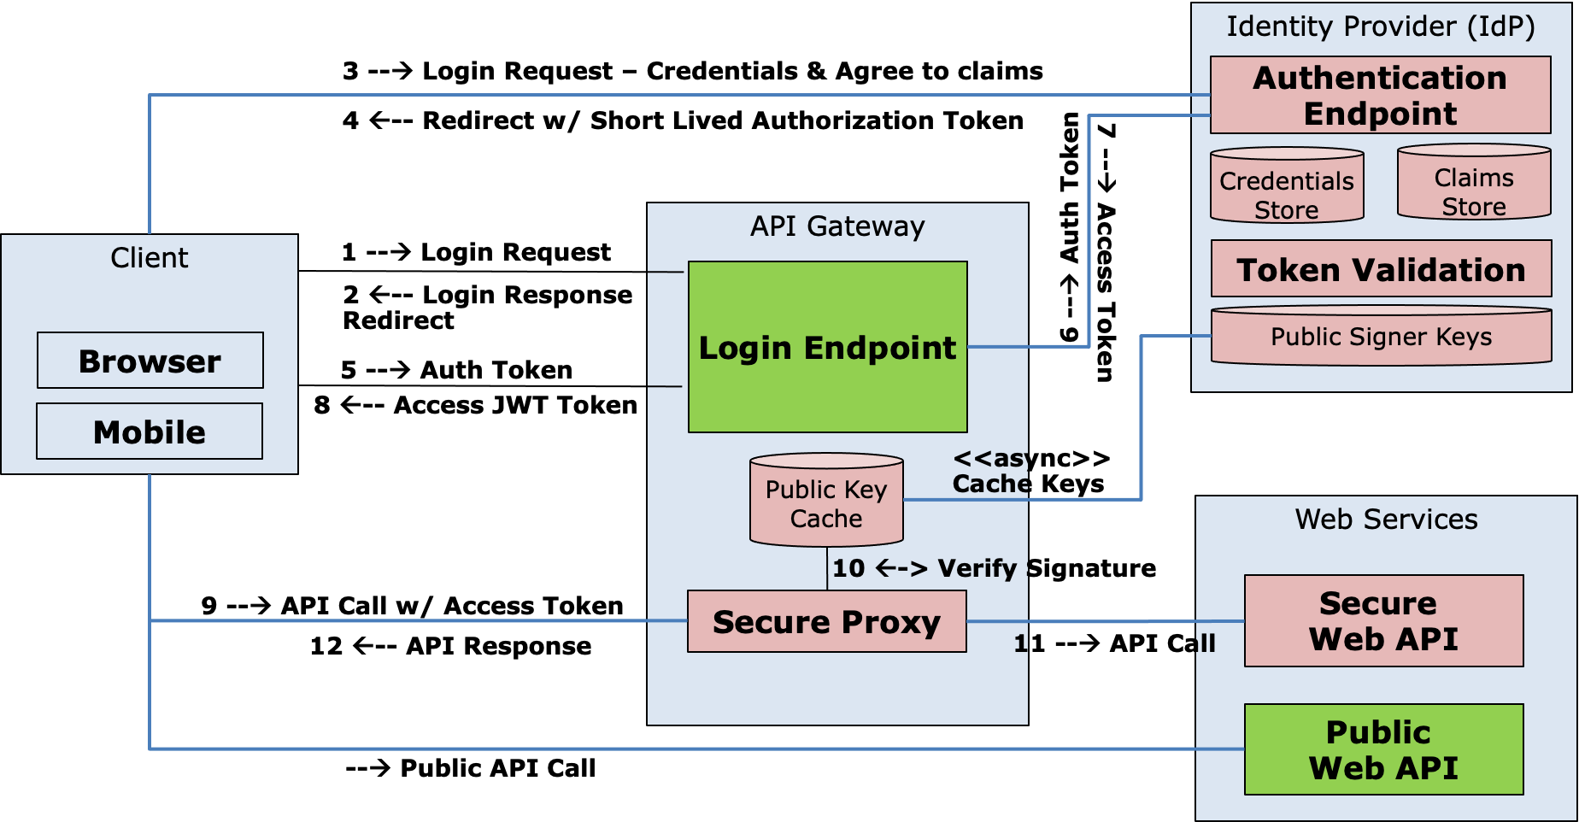
Web 2.x Security Architecture – oAuth Based Security
Works well, time tested
Very secure and flexible
Works with a variety of different client devices, not just browsers
Intrinsically supports federation given the IdP can be internally owned or external
Has other features that were not covered such as referesh tokens that allow for long lived “remember me” scenarios
Google Maps
GMail

Slide 64
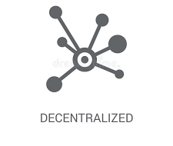


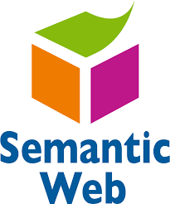
Web 3.0 Objectives – Possibly what’s next
Web 3.0 Objectives Will Require Significant Architecture Changes to the Web
Decentralized Computing: Edge computing becomes the primary model – in Web 2.0 most transactions happen via APIs owned by centralized parties; Web 3.0 the endpoints directly sell, exchange or barter their data without loosing ownership control. The middleman goes away
Open, Trustless & Permissionless: Open in applications built from open source software; trustless in that the network itself allows participants to interact publicly or privately without a trusted third party; permissionless in that anyone, both users and suppliers can participate without authorization from a governing body
Connectivity and Ubiquity: We are starting to see this emerge in web 2.0; but web 3.0 is assuming that the web will be everywhere – connecting everything without any hardware or software limitations
Semantic Web: AI and ML will replace web 2.0s “query based” model to find information with deep personalization and relevance to the user and their current context
https://www.monocubed.com/blog/what-is-web-3-0/
Google Maps
GMail

Slide 65
Web 3.0 Also Introduces New Capabilities that Impact the Architecture
Web 3.0 Objectives Will Require Significant Architecture Changes to the Web
Reimagining Security: Identity moved to edge owned by individual users vs centralized identity providers making large breaches difficult, also the model moves to zero trust where secure connections are setup for every network interaction
Monetization of Users Attention vs Data: Web 2.0 largely monetizes its “free” services via targeted ads, however targeted adds require massive data collection and data processing leading to privacy issues. Web 3.0 focus shifts away from pushing ads to enabling companies to compete for your attention in the open using things like nonfungible tokens (NFTs)
Digital Products and exchange: With web 3.0 tangible digital assets can be created and exchanged using technologies such as blockchain. Examples, digital currency, selling digital content, music, movies, etc. NFTs can also be used to represent and exchange physical assets without intermediary third parties – art, real estate, event tickets, etc.
Google Maps
GMail

Slide 66
Before we get into the architecture of Web3, an example is required to understand it.
Scenario: You work for a large company that provides you healthcare coverage, you injure your knee, go to the doctor, the doctor orders an MRI. Possible outcomes:
You get the MRI, and then a week later an email pointing you to an explanation of benefits showing that the service was fully covered, your cost is $0, and you are happy
You are told by the doctor that you need an MRI, but your insurance requires a pre-authorization approval, and it might take up to a week. The MRI is approved, you get the MRI and then a week later a bill shows up for $50.
Same as above, but you get a bill for $750 (or any other amount that is calculated)
Same as above, but you call the insurance company, file an appeal, and then two weeks later a decision is made. The result could be your bill is adjusted to a much smaller amount, even $0, or your appeal can be denied, making you responsible for the full amount
Your doctor wants you to get an MRI, tells you that a prior authorization is required, but the prior authorization is denied. If you want the MRI you have to pay the full cost, which could be several thousand dollars
How can the same scenario lead to such a diversity of outcomes that impact cost and customer satisfaction?
Google Maps
GMail

Slide 67
What is a prior authorization, and why are these things even necessary
The cost of healthcare in the US in 2019 has been reported as $3.8T, which is by far the largest category of spending in the US – about 18% of the total economy and approximately $11.5K for every person in the US
Most people don’t understand healthcare, and fully place trust in doctors. Thus, people think if a doctor says you need something, it must be necessary. However, doctors can be inconsistent, thus there is a need to improve consistency to manage overall healthcare costs
Doctors are inconsistent, some are very conservative and order tests – “just in case”, and some doctors are even fraudulent, for example, they may own a stake in an imaging lab, or get referral fees.
We see imaging labs all over the place, they are out for profit, and the equipment that they use is expensive. Thus, the cost for the same procedure can vary widely from one imaging center to another
Most people view processes like prior authorizations as a scheme by healthcare providers to deny coverage, and thus stuff their pockets with more profits. Many don’t know that many commercial plans have the employer pay all medical costs, and healthcare companies get paid fees to leverage their networks and expertise. Thus, if a prior authorization is approved or denied, in many cases it does not impact in any way the amount of money a healthcare company spends or profits that they make.
At the end of the day, nobody likes this process, but many agree its necessary
Google Maps
GMail

Slide 68
But how can the outcomes for the same use case differ?
Healthcare is provided to employers, with the terms and conditions outlined in a legal contract. The systems that healthcare companies use to process claims are based on algorithms. Thus interpretation is sometimes needed between a legal contract and an algorithmic decision.
Healthcare companies deploy multiple strategies to lower the cost of making pre-authorization decisions, many of these things are not visible to patients consuming healthcare services
From a scale perspective, healthcare companies negotiate preferred rates with certain imaging providers to drive more volume to their services. What's good about this? There is transparency in terms that clinical best practices are followed – if they are not followed, the lab will not get paid. Patients and employers benefits from lower contracted rates
From a customer satisfaction perspective, healthcare companies offer incentives to providers to follow their prior-authorization best practices. Once a provider gets onto this list, they no longer have to get a pre-authorization as its expected that the provider applied best practices and are steering customers to the lowest cost, and highest quality imaging labs.
Why should you care? Would you be willing to drive 2 additional miles to go to an alternative imaging lab that saves you or your employer several hundred dollars?
Google Maps
GMail

Slide 69
How doe healthcare companies monetize prior authorization services?
All healthcare companies deploy prior authorization as a best practice, how do healthcare companies monetize this service?
In many cases healthcare companies cant and do not charge for prior authorization services. The costs to support this process is baked into healthcare premiums. That said, many healthcare companies use either third party experts, or third party software to make prior authorization decisions. Thus prior authorization is an expense and not a profit item.
Healthcare companies that do prior authorization well, use this as a competitive advantage when selling their overall services to clients, thus doing this well can increase overall sales and profits
Healthcare companies realize that prior authorization is accepted as necessary by providers and clients, but nobody really likes it because of issues like patient satisfaction, and occasional delays medical services.
Business Objective: Healthcare companies that can apply algorithmic decisions to making prior authorization decisions have a massive opportunity to lower costs, improve clinical quality, and improve patient satisifaction
Google Maps
GMail

Slide 70


Architecture for Prior-Authorization in Web2
Prior Auth Request API
Healthcare Backend Systems
Prior Auth Requests
Prior Auth Software
Doctors
Prior Auth Decision
API
Healthcare Network Contracts
Manual Reviewers
Prior Auth Decision
Claim Submission API
Labs
Customer Healthcare Service Contract
Claims Engine
Bill $$$$$
Patient
Google Maps
GMail

Slide 71
Architecture for Prior-Authorization in Web2
Prior Auth Request API
Healthcare Backend Systems
Doctors
Prior Auth Decision
API
The healthcare provider must be considered a centralized trusted entity
They own the overall decisions yet how these decisions are made are not transparent to Patients
Claim Submission API
Labs
Bill $$$$$
Patient
Google Maps
GMail

Slide 72

Architecture for Prior-Authorization in Web3
Prior Auth Request API
Decentralized and permissionless Blockchain
Prior Auth Smart Contracts
Doctors
Prior Auth Decision
API
Claim Processing Smart Contracts
Claim Submission API
Blockchain Ledger
Labs
Bill $$$$$
Decisions typically based on trust from a central entity are now transparent over a decentralized network
Patient
Google Maps
GMail

Slide 73
API in Web 2 vs Smart Contracts in Web3 from an Architecture Perspective
Centralized Entity, e.g., A company
API Call
API Interface
Application
API
API Data
API Interface Documentation
JSON over HTTP
APIs exposed over public internet
APIs (usually) provide documentation over interfaces, actions they perform, outcomes and errors
Entities who provide the API are trusted to fulfil the responsibility of the API
Examples: Send a venmo transaction for $25 to a friend, order a teeshirt over amazon, etc
Examples: Trust must be provided to the entity supplying the API given they do not make available their databases, logs, or API algorithm implementations for reviews. Appeals when there is disagreement or dissatisfaction is not easy – e.g., ”I want a refund, I never received my package”
Google Maps
GMail

Slide 74
Blockchain Architecture – The blockchain
Blockchain
Pending Transactions
Block 1
Block 2
Block …
Block N
x x x
Block N+1
Pending Transactions
Pending Transactions
Pending Transactions
A blockchain is a linked list of blocks, each block containing a validated collection of transactions
A blockchain is distributed and replicated, all parties can view the same thing
Blockchain miners perform a complex process to mint new blocks from pending transactions, but once minted, the correctness of the block is easily verified by all parties
Blockchain miners compete for awards via fees and tips to mint new blocks
Blockchain Miner(s)
Blockchain
Pending Transactions
Block 1
Block 2
Block …
Block N
Block N+1
Pending Transactions
Pending Transactions
Pending Transactions
Google Maps
GMail

Slide 75
Blockchain Architecture – The smart contract
coin
cost – total-money
coin
State Machine Code
Initial state
Accumulate Money
Dispense Product
Refund Overpayment
State Change Trigger
Send Refund
State Change Trigger
Product Selection
total-money > cost
Refund Overpayment
State Change Trigger
Transaction-finished
A “smart contract” is basically a state machine. The logic for the state machine is recorded on the blockchain itself
Since on the blockchain, its behavior is open to all to review, is immutable, and cant be changed (but it can be evolved)
All state changes are recorded on the blockchain open to be validated to all – If I paid a coin, all would see it and a merchant could not claim that I did not
Changes in state happen automatically once all of the preconditions are satisfied
Google Maps
GMail

Slide 76
Returning to the Pre-Auth example via smart contract
denied
yes
approved
Service provided
Patient selection
Initial state
Preauth Required
Preauth Rules
Imaging Center Selection & Costs
Imaging Center Services
Patient Billing Calculation
Doctor Requests Imaging
approved
preauth approval
Patient Payment
Provider preferred – auto-approved
The previous pre-auth experience was not fully transparent to all participants – lends itself to suprises and dissatisfaction
The smart contract makes concepts such as preferred providers, the rules around if a pre-auth is required, how are they approved or denied, cost transparency around location selection and how payment is made transparent to all parties.
There are no secrets, nor the ability to alter how this works
Identities and patient information is protected via private keys, just like in other blockchains
Google Maps
GMail

Slide 77
Fungible Tokens
A fungible token is divisible, interchangeable and non-unique. Crypto-currency is an example. For example, 10 individual bitcoin transactions in a wallet is equivalent to one transaction containing 10 bitcoins. Fungible tokens are often divided when exchanged.
Example, I have a transaction on the blockchain indicating my ownership of 10BTC, and want to send you 6 BTC
TransactionID: 123 $10BTC Owner: abcd
Transaction SPEND: TX-123 Send: $5BTC, To: wxyz Send: $4.95 BTC, To: abcd
TX-456 $5BTC Owner: wxyz
TX-789 $5BTC Owner: abcd
Transactions are immutable, to exchange a fungible token, a new transaction is created that “spends” the old one and divides it into multiple parts. One part to new party, the other is change. The reminder is a fee/tip to the miner to incent them to put on a block.
Google Maps
GMail

Slide 78
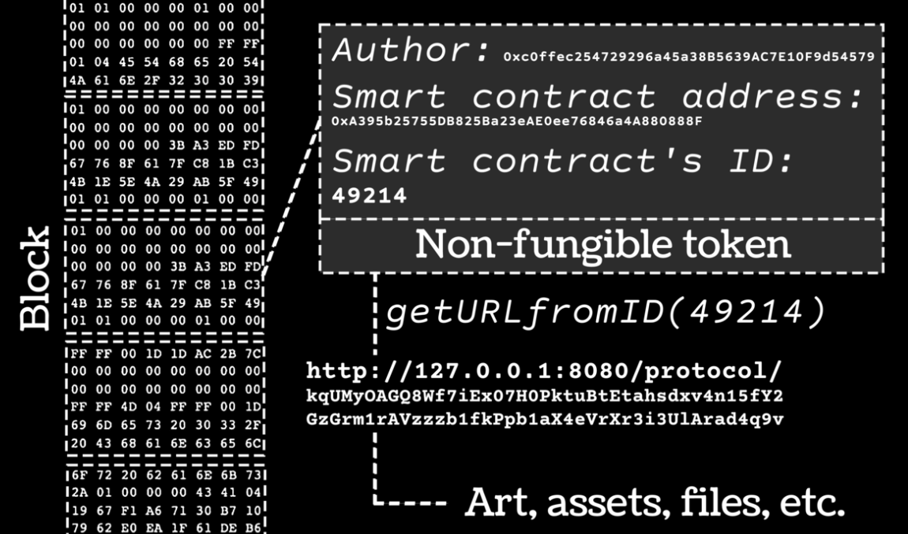
Non Fungible Tokens
The other interesting thing about Web3 is the ability to create and own digital assets
The obvious example is crypto-currency where crypto currency can be used directly in commerce or also be exchanged for fiat money such as US Dollars.
A NFT is just a digitally signed token that is stored on the blockchain – they can be owned or exchanged just like any other crypto-token
Examples:
Car and home titles
Insurance contracts
Birth/Marriage/Death certificates
Electronic art
Intellectual property
Google Maps
GMail

Slide 79
Non-Fungible Tokens
(google ERC-721 for the definition of the standard for NFTs, note the below is simplified to demonstrate the concepts in the architecture)
A non-fungible token is used to assert ownership of an asset.
Example, I mint a NFT asserting my ownership of a car, then I gift it to my son. In this example, my wallet id is “abc”, and my son’s wallet id is “xyz”
1
2
3
TransactionID: 123 MINT-NFT NFT-ID: 12-34-56
NFT-CREATOR: abc
NFT-OWNER: abc
Data: {type: auto-title,…}
TX-456 Send-NFT NFT-ID: 12-34-56
From: abc
To: xyz Dig-Sign(Priv-Key(abc), Hash(NFT-ID,From,To))
TX-789
NFT-ID: 12-34-56 NFT-OWNER: xyz
A NFT can be created by anybody via self minting. Notice when an NFT is created its given a unique ID and has other attributes such as metadata about the NFT itself
When an NFT is going to be exchanged, a new transaction/smart contract is executed, showing ownership transfer using “to” and “from”. Notice the private key of the current owner is used to digitally sign the transactions to prove that they are transitioning ownership. The signature can be easiely verified via the public key
Once ownership is transferred, notice the NFT-ID does not change, it never will change. This shows linage back to the original creator of the NFT.
Google Maps
GMail

Slide 80
Semi-Fungible Tokens
(google ERC-1155 for the definition of the standard for SFTs, note the below is simplified to demonstrate the concepts in the architecture)
A semi-fungible token is basically the same thing as a NFT, with one minor difference
NFTs are unique, and when they are minted are tied to exactly one asset
Semi-Fungible tokens (SFT) can be minted with a quantity. For example mint a “lot” of NFTs. When an SFT is minted, its quantity is fixed and can not be altered up or down.
Example, I can issue 100 SFTs for a piece of artwork, either digital or physical. Thus each SFT represents 1/100 ownership of the physical asset. You can of course, own more than one SFT for an asset thus increasing your ownership stake
If you mint a SFT with quantity 1, then its basically a NFT.
Google Maps
GMail

Slide 81
Selling Non- or Semi-Fungible Tokens
We just covered how to exchange a NFT and SFT, hopefully you can see how we can not only exchange but sell the transfer of rights with a SFT via smart contracts
Contract 1 – Sell NFT 123
Contract 1 – Buy NFT 123
Advertise for sale
Pay
Mint NFT 123
Sell NFT for 100 coins
Buy NFT 123
Send 100 coins from wallet xyz
coins received
NFT Received
Received
100 coins from wallet xyz
Transfer NFT 123 to wallet xyz
Receive token of ownership for NFT 123
Payment received
Conceptually a buyer creates a contract offering to sell an NFT, and a buyer creates a contract to buy an NFT. Note that state changes happen automatically when events are triggered via the contract
Google Maps
GMail

Slide 82
API in Web 2 vs Smart Contracts in Web3 from an Architecture Perspective
Centralized Entity, e.g., A company
API Call
API Interface
Application
API
API Data
API Interface Documentation
JSON over HTTP
Decentralized Entity
API Call
API Interface
Smart Contracts
Application
Blockchain
JSON over HTTP
Architecturally, the concepts make sense, but the current-state-of-the-art blockchain technology is hard to scale and introduces other challenges that need to be overcome for this to be a practical solution
Google Maps
GMail

Slide 83
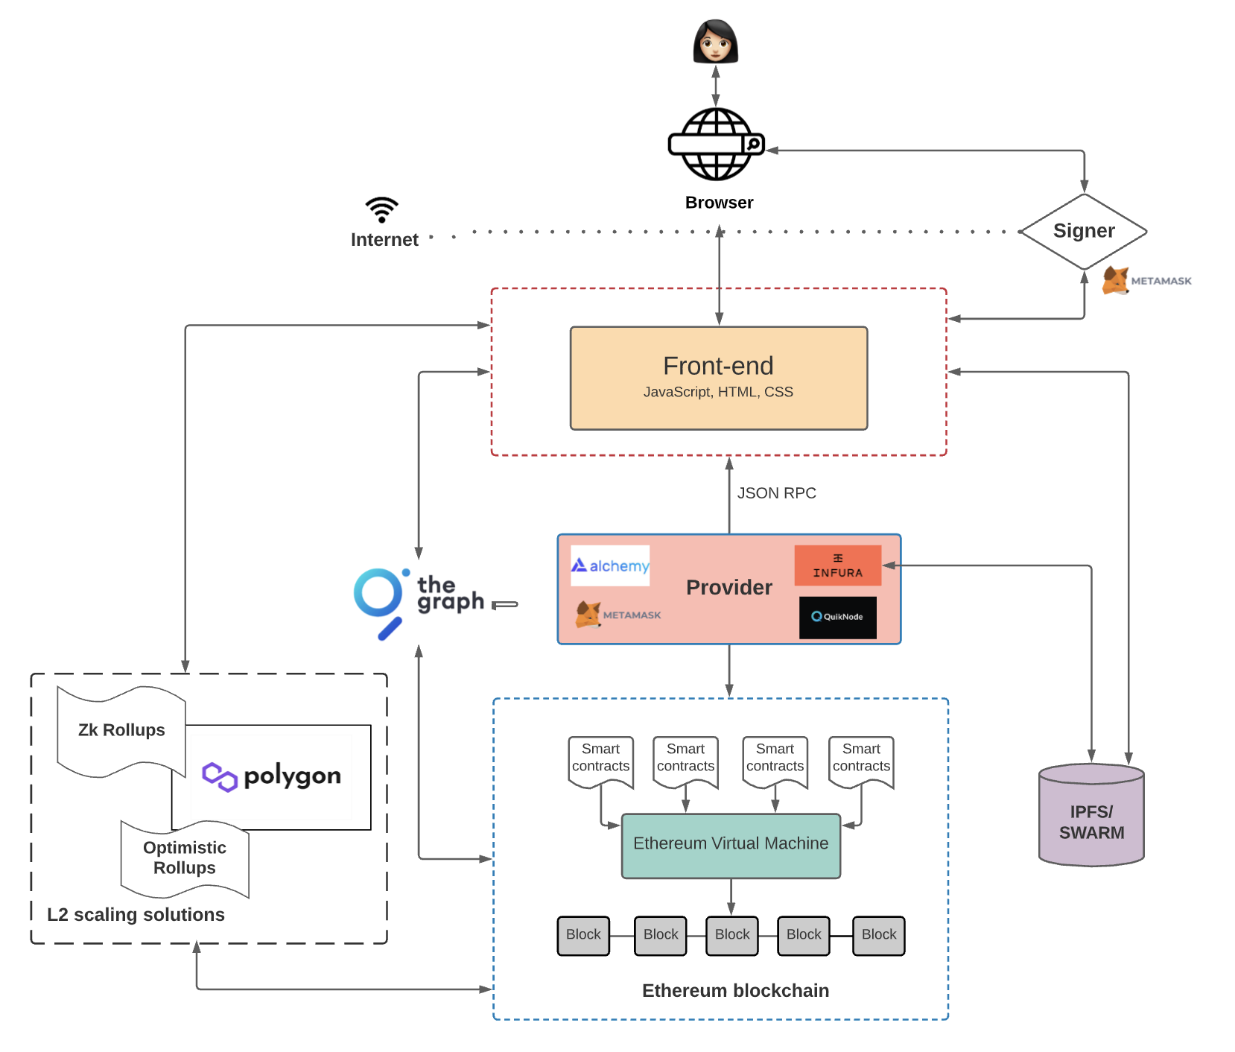
Web3 – More Realistic Architecture
User interface code similar to Web2 solutions
Assists with signing and private keys for security and privacy
Optimized service for querying the blockchain
Intermediary between your app and the blockchain, not needed if you want to run your own blockchain nodes
Scaling solution for executing transactions off chain and then periodically merging
Cost effective off chain storage for intermediate state changes
Smart Contracts persisted in the blockchain
https://www.preethikasireddy.com/post/the-architecture-of-a-web-3-0-application
Google Maps
GMail

Slide 84
Web 3.0 Summary
Significant Technical Challenges exist for Web3 to overtake Web2, Time will Tell
The more likely outcome is that Web3 will coexist and complement Web2 for some time into the future
Google Maps
GMail

